Slide 1
An Analysis of Power and Water consumption and GHG Emission of large buildings in Ontario, Canada
Name: Shankar Ghimire
Student ID#: 501177872
Supervisor: Ceni Babaoglu, PhD
Program: Data Analytics, Big Data, and Predictive Analytics
Date: December 02, 2024

Slide 2
Abstract and Dataset
The dataset on ‘Energy and water usage of large buildings in Ontario’ provides comprehensive information on various aspects including property types, energy and water consumption, greenhouse gas emissions, and energy efficiency scores etc. This research will explore the dataset and aims to find the following insights:
What are the key drivers of energy efficiency scores across different property types?
How do greenhouse gas (GHG) emissions vary by location and property type?
What is the relationship between water usage and energy consumption in large buildings?

Slide 3
Abstract and Dataset cont...
The dataset contains 6,864 rows and 32 columns.
Some major attributes/columns:
City
Postal Code
List of All Property Use Types
Third-party Certifications
Electricity Intensity (GJ/m2)
Natural Gas Intensity (GJ/m2)
All Water Use Intensity (m3/m2)
Indoor Water Use Intensity (m3/m2)
GHG Emissions Intensity (kgCO2e/m2)
ENERGY STAR Score
ENERGY STAR Certification

Slide 4
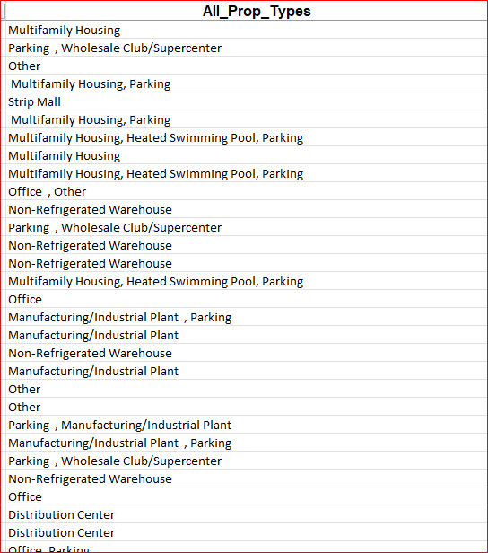
Abstract and Dataset cont...
Property Types is the key attribute in the dataset to conduct the analysis, but its values look not so consistent in the original dataset.

Slide 5
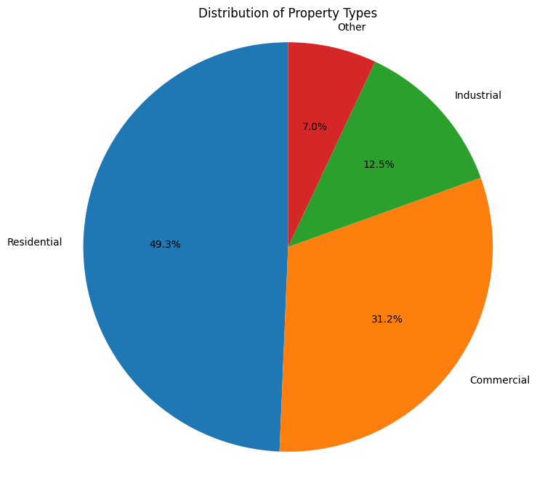
Abstract and Dataset cont...
As a process of ‘Feature Engineering’, a new attribute ‘Property_Type’ has been mapped based on ‘All_Prop_Types’
Mainly categorized the property types into four groups:
Industrial
Commercial
Residential
Other

Slide 6
Literature Review
Introduction:
Understanding the key drivers of energy efficiency scores in the various property types is very important for developing better strategies to enhance the performance of large buildings
Greenhouse gases (GHGs) such as Carbon Dioxide (CO2), Methane (CH4), Nitrous Oxide (N2O) etc. are the gases in the atmosphere that raise the surface temperature of the Earth.
research aims to highlight the areas and property types with the highest emissions

Slide 7
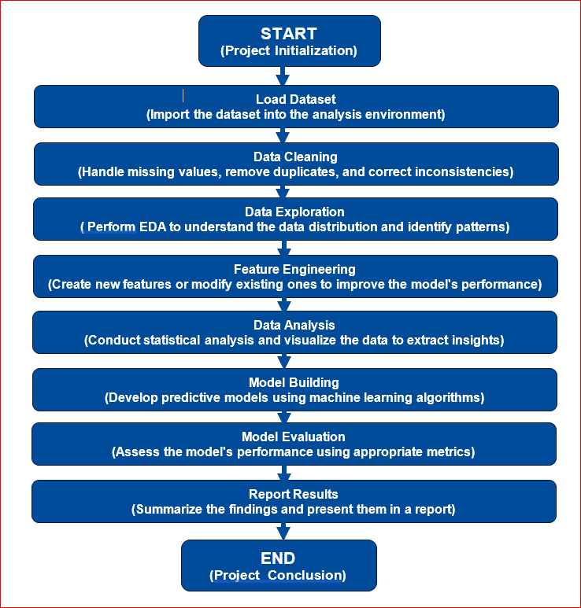
Research Methodology

Slide 8
Model Selection and Performance
Random Forest Model
Selected Features and Target Attributes
Features:
All_Prop_Types
WN_Sit_Elc_Int1
WN_Sit_Gas_Int1
All_water_Int1
Target:
Ener_Start_Score

Slide 9
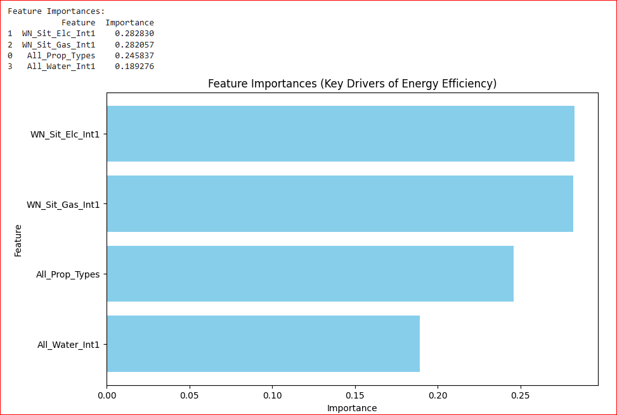
Model Selection and Performance cont…
Features importance

Slide 10
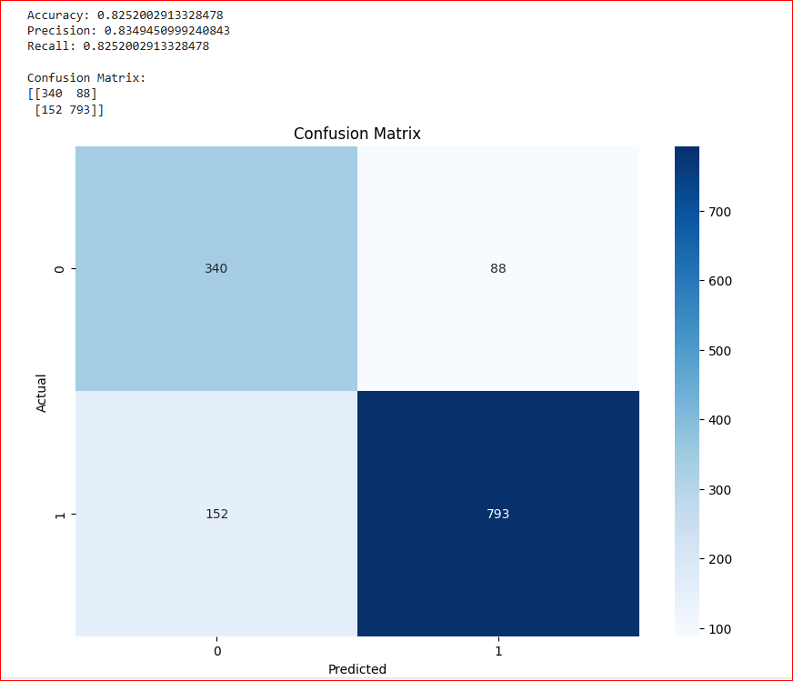
Model Selection and Performance cont…

Slide 11
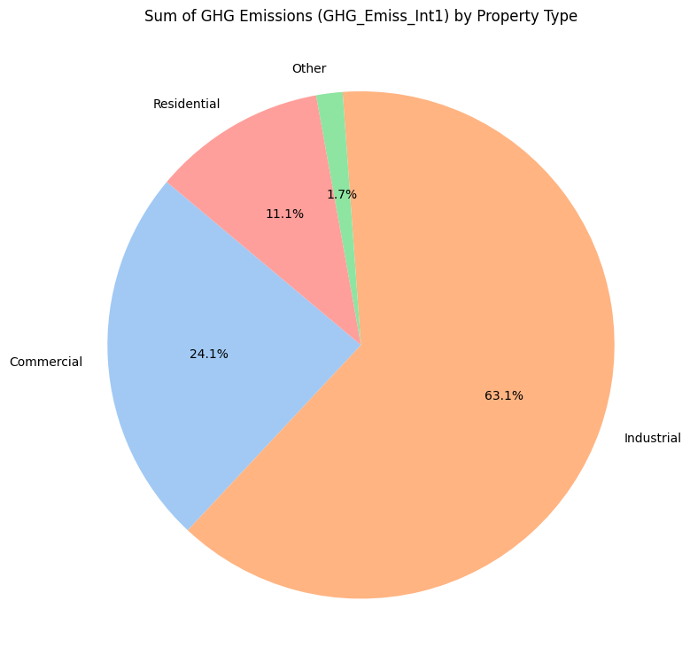
Model Selection and Performance cont…
Total GHG emission by Proper Types

Slide 12
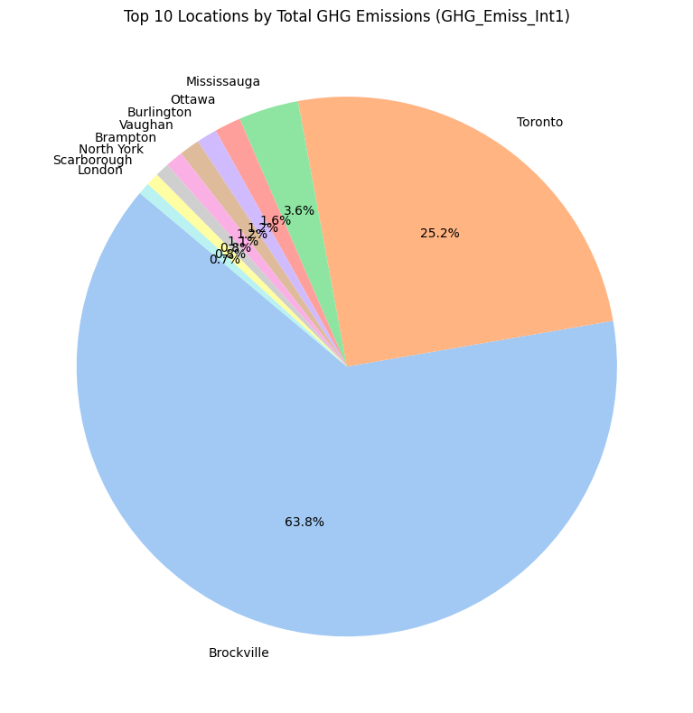
References
Top 10 City/Location GHG emission

Slide 13
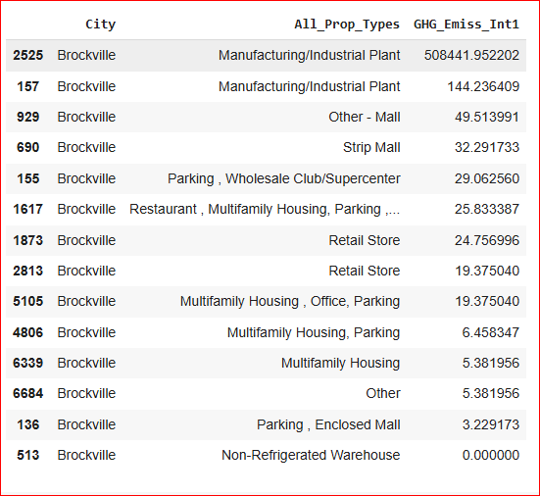
Model Selection and Performance cont…
Brockville data

Slide 14
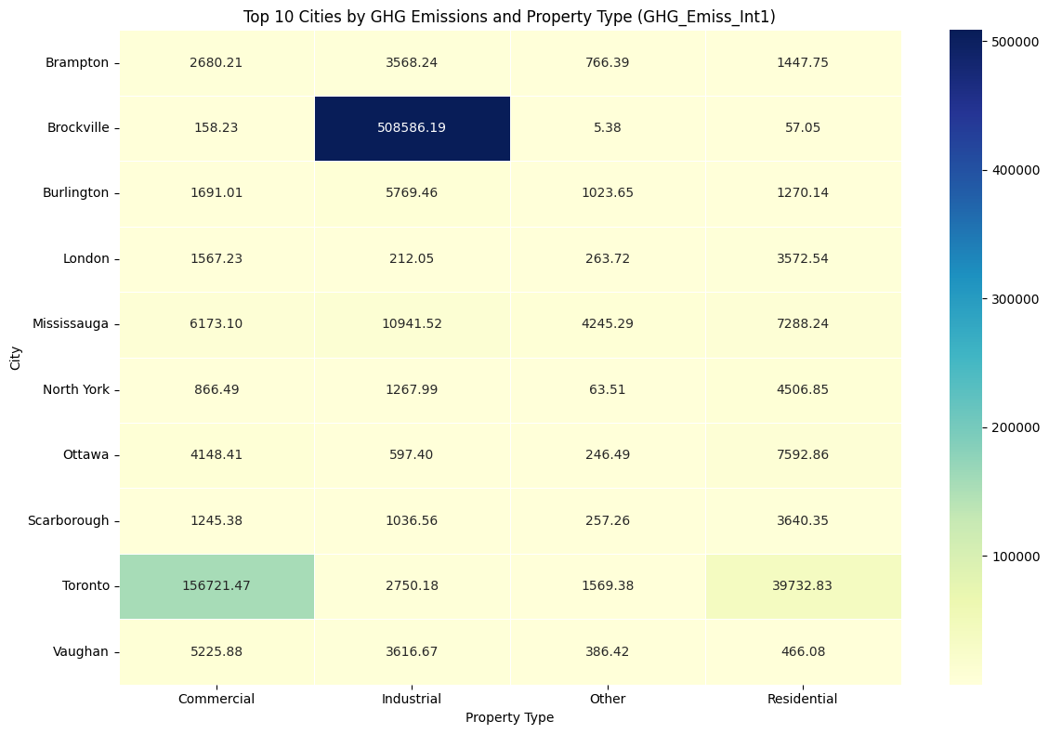
Model Selection and Performance cont…
Top 10 Cities with GHG emission and Property Types

Slide 15
References
Analysis of Improvement in the Energy Efficiency of Office Buildings Based on Energy Performance Certificates Bliūdžius, Raimondas; Banionis, Karolis; Monstvilas, Edmundas; Norvaišienė, Rosita; Adilova, Dinarr; et al. Buildings; Basel Vol. 14, Iss. 9, (2024): 2791. https://www.proquest.com/docview/3110416435/88312EBB29EC4E30PQ/9?accountid=13631
Assessing greenhouse gas emissions and energy consumption in SMEs OECD SME and Entrepreneurship Papers; Paris, 42 pp.Oct 17, 2023. https://www.proquest.com/docview/3051090090/D418F23D789B4B2EPQ/35?accountid=13631
Assessing water, energy and emissions reduction from water conservation measures in buildings: a methodological approach Meireles Inês; Sousa Vitor. Environmental Science and Pollution Research; Heidelberg Vol. 27, Iss. 5, (Feb 2020): 4612-4629.https://www.proquest.com/docview/2288312158/88312EBB29EC4E30PQ/4?accountid=13631
Building energy consumption analysis and measures: a case study from an administration building in Chengdu, China Zhang, Junye. Energy Informatics; Heidelberg Vol. 7, Iss. 1, (Dec 2024): 78. https://www.proquest.com/docview/3099952516/88312EBB29EC4E30PQ/13?accountid=13631
Variations in direct greenhouse gas emissions across neighbourhoods: A case of Edmonton in Canada NPY Welegedara, SK Agrawal, S Gajjar… - Environmental Challenges, 2021 - Elsevier https://www.sciencedirect.com/science/article/pii/S2667010021002900

Slide 16
References cont…
Energy consumption and greenhouse gas emissions by buildings: A multi-scale perspective YL Li, MY Han, SY Liu, GQ Chen - Building and Environment, 2019 - Elsevier https://www.sciencedirect.com/science/article/pii/S0360132318306917
Energy consumption in residential buildings: Comparison between three different building styles MA Umbark, SK Alghoul, EI Dekam - Sustainable Development …, 2020 - core.ac.uk https://core.ac.uk/download/pdf/288300515.pdf
Modeling the determinants of large-scale building water use: Implications for data-driven urban sustainability policy CE Kontokosta, RK Jain - Sustainable Cities and Society, 2015 - Elsevier https://www.sciencedirect.com/science/article/pii/S2210670715000633
Variations in direct greenhouse gas emissions across neighbourhoods: A case of Edmonton in Canada NPY Welegedara, SK Agrawal, S Gajjar… - Environmental Challenges, 2021 - Elsevier https://www.sciencedirect.com/science/article/pii/S2667010021002900

Slide 17



